Slide 1


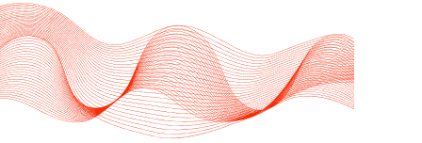
IOT
SMART ENERGY HARVESTING USING FOOTSTEPS
Presented by:
Geeth Vishnu - CB.EN.U4CSE21119
Vakada Rohit - CB.EN.U4CSE21165
Gowtham Veluguri - CB.EN.U4CSE21166

Slide 2
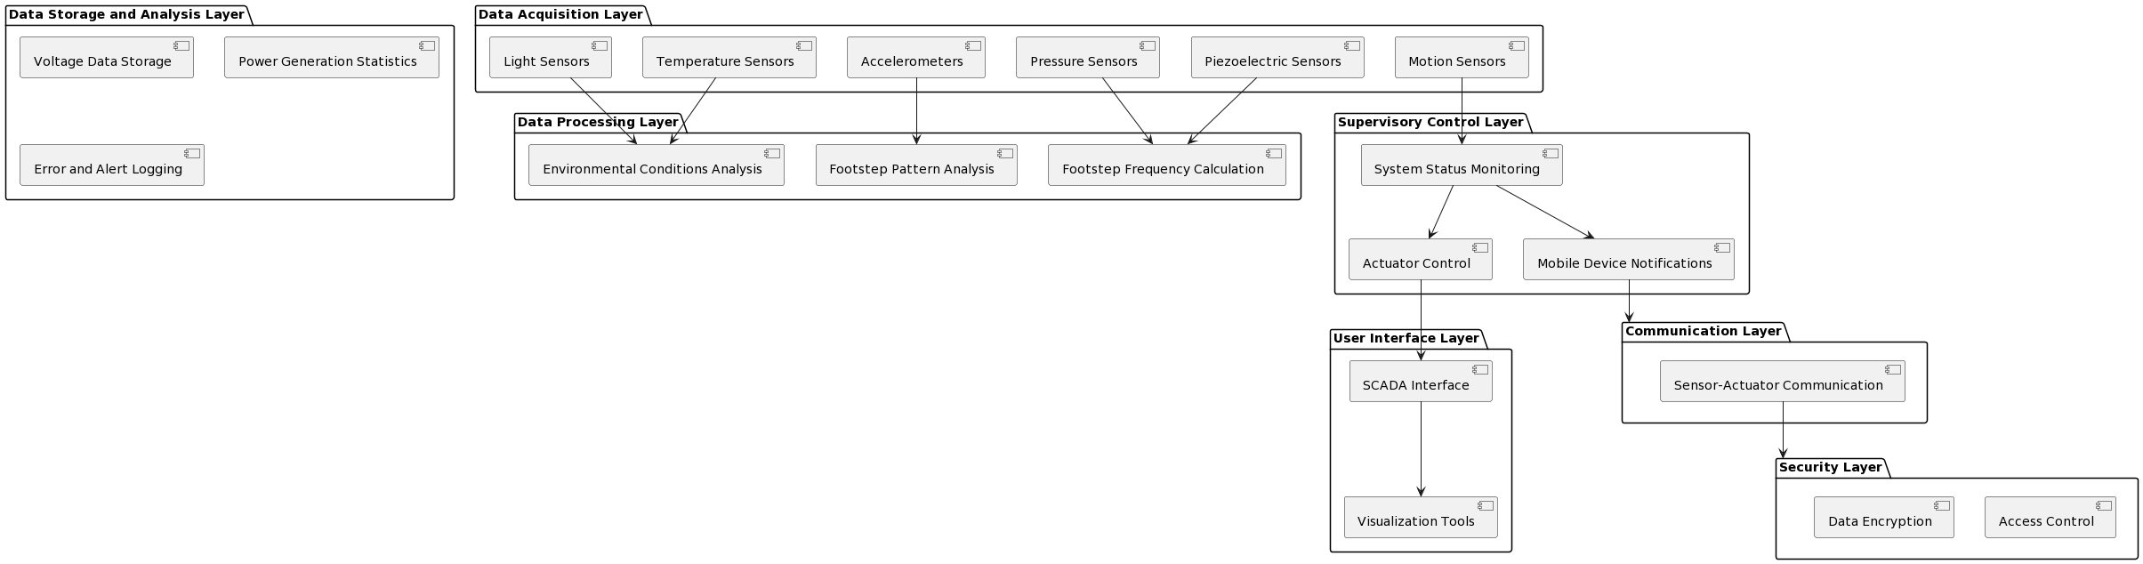
SUPERVISORY CONTROL AND DATA ACQUISITION
SCADA (Supervisory Control and Data Acquisition) model for optimizing energy harvesting from footsteps.
Integration of sensors, actuators, and data collection components to monitor, control, and optimize the energy harvesting process through different layers.

Slide 3
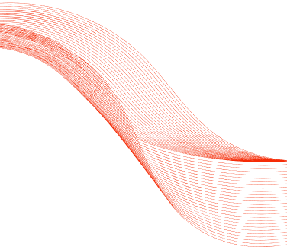
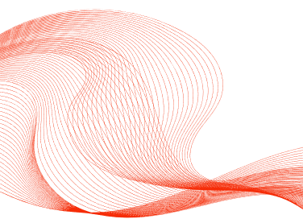
SCADA MODEL
Data Acquisition Layer
Data Storage and Analysis Layer
Piezoelectric Sensors
Data Collection Interval
Voltage Data Storage
Power Generation Statistics
Error and Alert Logging
Data Processing Layer
Footstep Frequency Calculation
Environmental Conditions Analysis
Footstep Pattern Analysis
Communication Layer
Sensor-Actuator Communication
Mobile Device Notifications
Security Layer
Supervisory Control Layer
Access Control
Data Encryption
System Status Monitoring
Actuator Control
Mobile Device Notifications
User Interface Layer
SCADA Interface
Visualization Tools

Slide 4
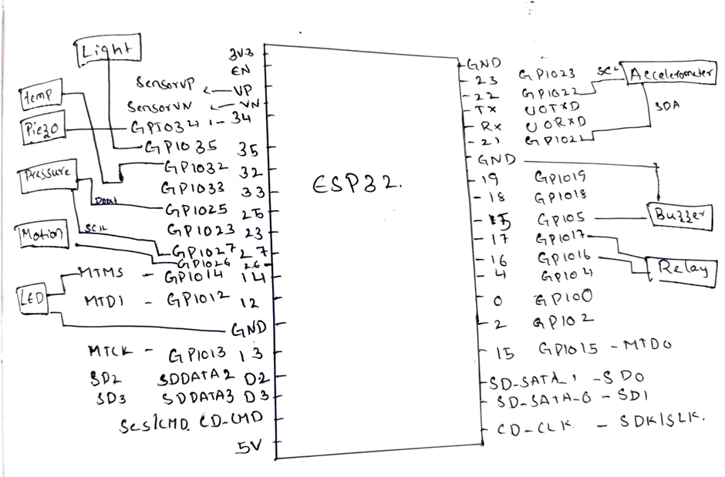
CONTROL UNIT DESIGN

Slide 5
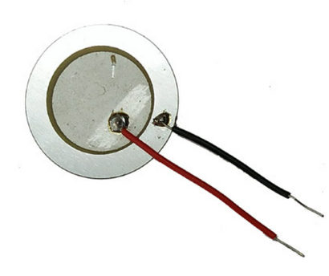
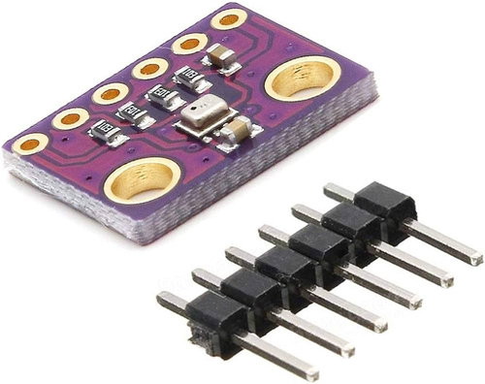
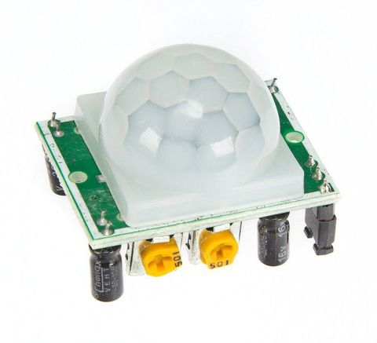
SENSOR PLACEMENT MODEL
Sensor placement incorporating piezoelectric sensors, pressure sensors, accelerometers, and motion sensors:
Piezoelectric
Sensors
Pressure
Sensors
Motion Sensor
Supplement piezoelectric sensors with pressure sensors to measure the force applied to the footstep platform by each footstep. Place pressure sensors in conjunction with piezoelectric sensors to provide additional data for optimizing energy generation and analyzing footstep patterns
Install motion sensors in the vicinity of the footstep platform to detect human movement and trigger the activation of the power generation system. Place motion sensors at entry points or along pathways leading to the footstep platform
Place piezoelectric sensors strategically on the footstep platform to capture mechanical energy from footsteps. Distribute sensors evenly across the surface to ensure maximum coverage and energy harvesting efficiency.

Slide 6
COMMUNICATION TECHNOLOGIES AND
TRANSMISSION PROTOCOLS
HTTP
WIFI
Hypertext Transfer Protocol
WIRELESS FIDELITY
HTTP (Hypertext Transfer Protocol) is the foundation of data communication on the web, enabling clients to request resources from servers via a stateless connectionless protocol.
WiFi is a wireless networking technology that allows devices to connect to the internet and communicate with each other using radio waves. It's commonly used for local area networking and internet access.

Slide 7
HARDWARE COMPONENTS
Piezo Electric Sensors
Pressure Sensors
Esp32 boards
Motion Sensor
Buzzer
Breadboard
Connecting wires
LED’s
Selection of hardware components is used to ensure its reliability, efficiency, and functionality.
Arduino Uno board

Slide 8
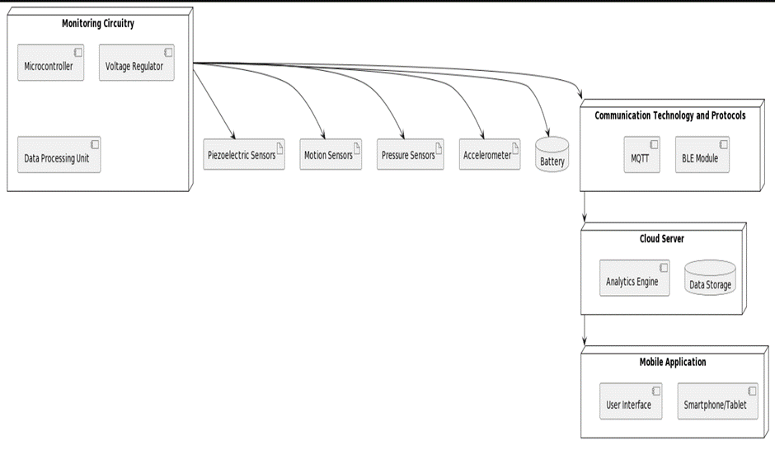
DEPLOYMENT LEVEL DIAGRAM

Slide 9
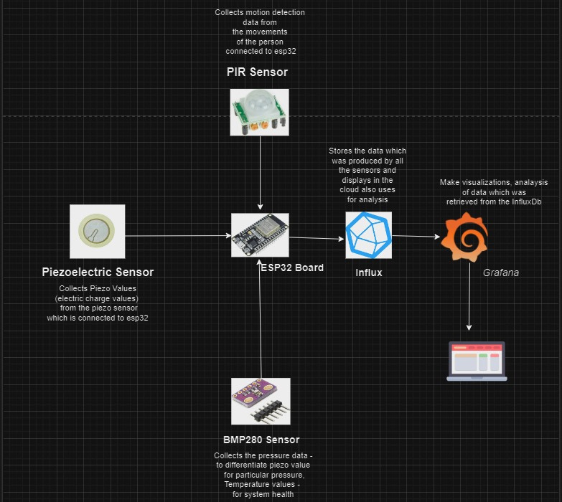
SOFTWARE
DESIGN

Slide 10
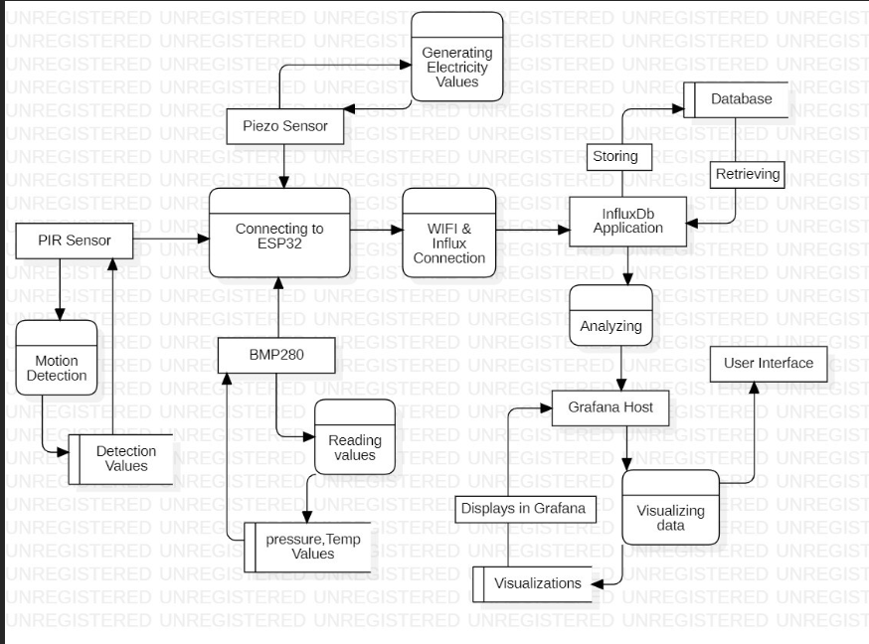
DFD

Slide 11
INTEGRATION WITH CLOUD
ESP32 boards and Arduino Uno equipped with piezoelectric, motion, and pressure sensors are configured as end devices to collect sensor data.
These devices perform basic preprocessing, converting analog signals to digital data and packaging it for transmission.
Acting as edge computing units, the ESP32 boards then forward the preprocessed sensor data to an InfluxDB instance deployed in the cloud. This data is transmitted via HTTP POST requests, ensuring reliable delivery to the cloud database.
Processed data is then sent to InfluxDB in the cloud for storage.
Grafana connects to the InfluxDB database to visualize the stored sensor data, allowing users to monitor pressure variations and motion events in real-time.

Slide 12
DATA ANALYTICS IN CLOUD
->Data analytics in the cloud for the Advanced Footstep Power Generation System offers insights into energy
generation, system performance, and user behavior.
->It enables analysis of footstep data for energy generation assessment, system monitoring for uptime and reliability and foot traffic patterns for optimization
-> Leveraging cloud analytics enhances system performance, reliability, and user satisfaction.

Slide 13
DATA ANALYTICS IN CLOUD
-> Energy Harvesting Efficiency:
Total Energy Generated: Calculate the total energy harvested over specific periods (hourly, daily, weekly).
->Footstep Analysis:
Footstep Count: Aggregate the total number of footsteps detected by PIR sensors.
Foot Traffic Patterns: Analyze foot traffic patterns to identify high and low traffic times
->Fault Detection: Identify anomalies that may indicate sensor faults or system malfunctions.

Slide 14
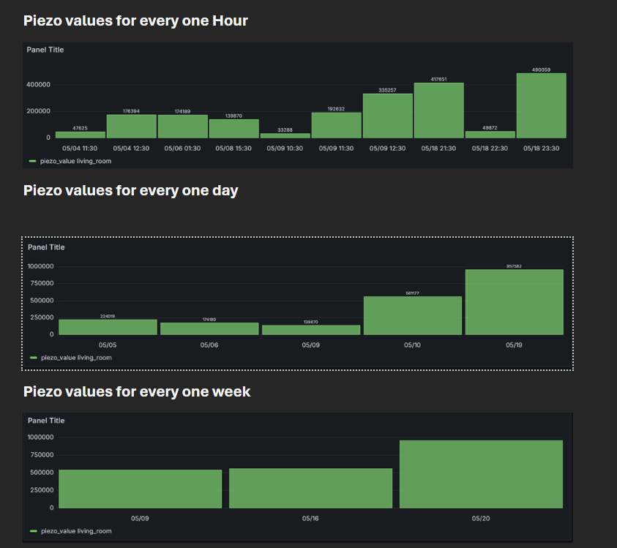
ENERGY ANALYSIS

Slide 15
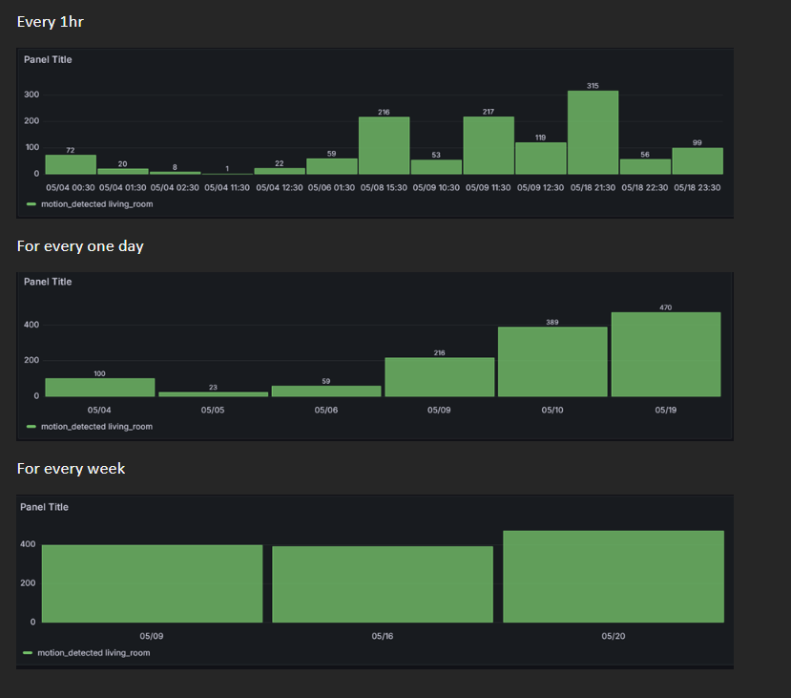
MOTION DETECTION

Slide 16
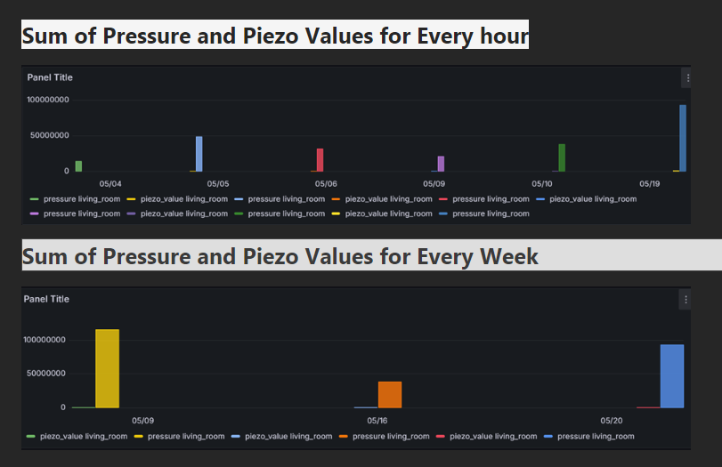
PRESSURE ENERGY ANALYSIS

Slide 17
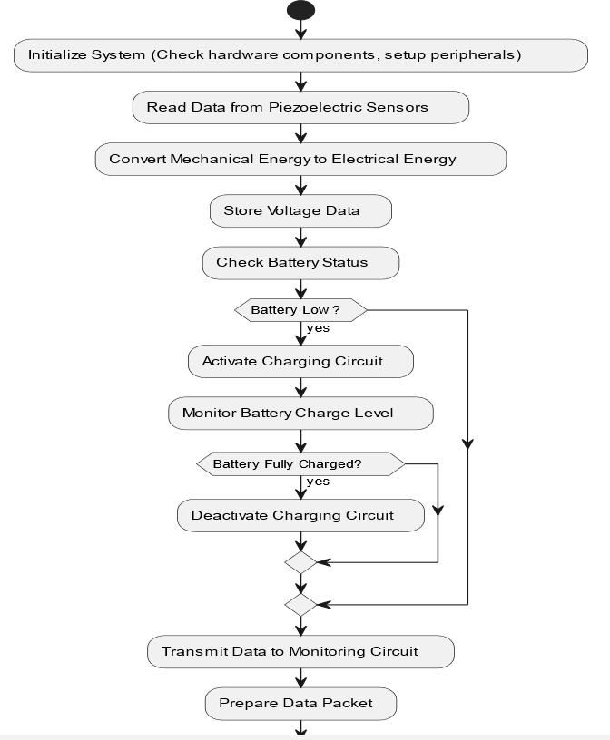
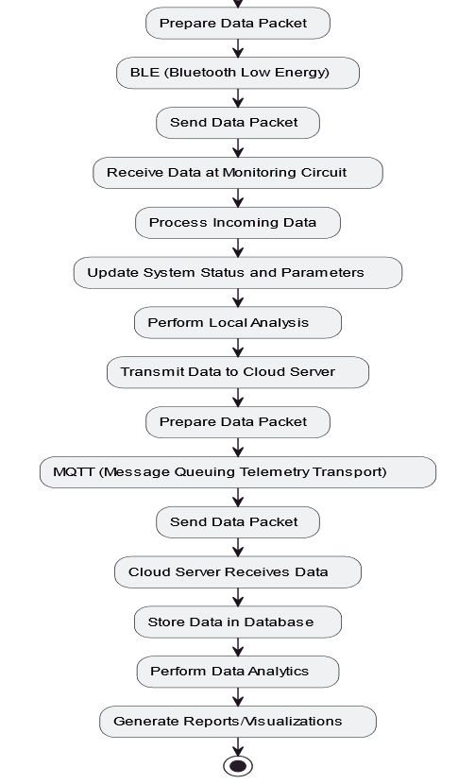
FLOWCHART

Slide 18
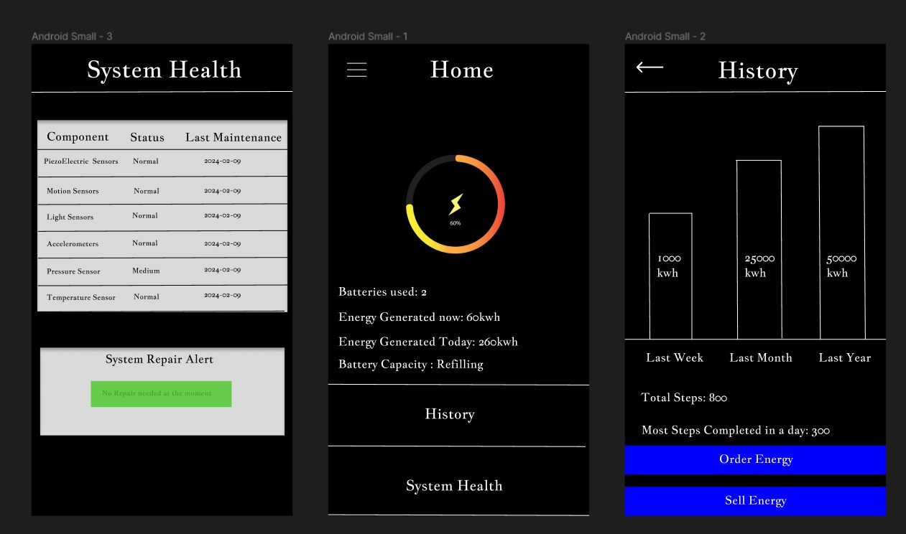
USER INTERFACE

Slide 19
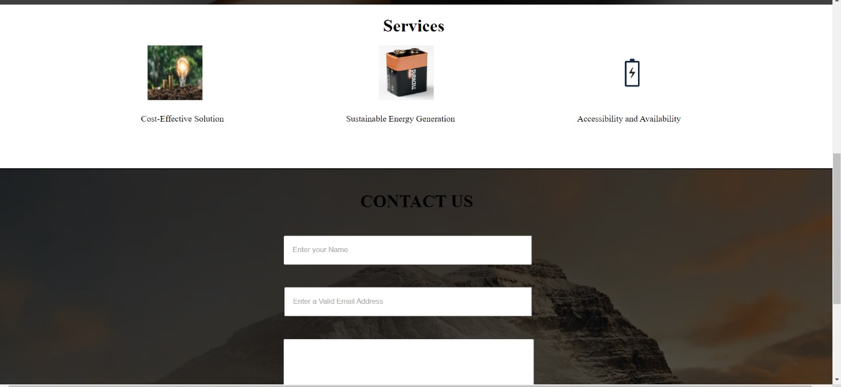
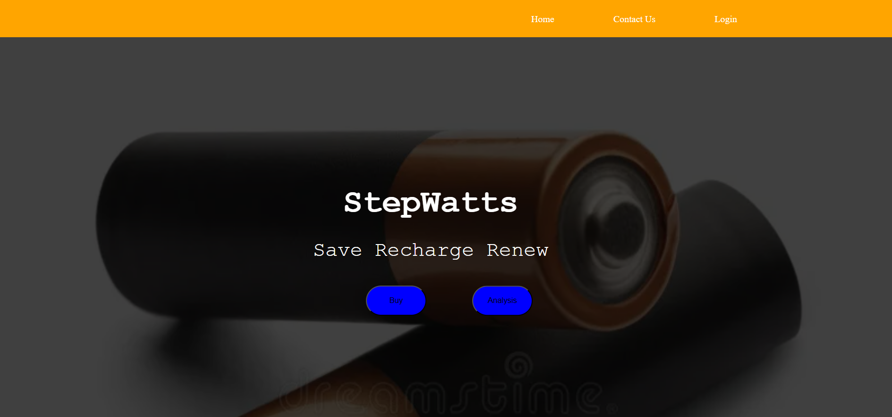
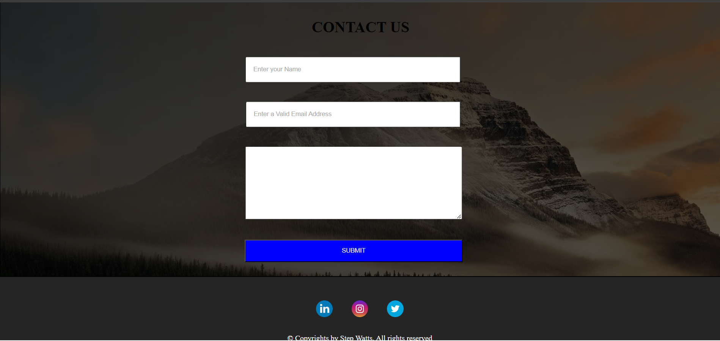
UI

Slide 20
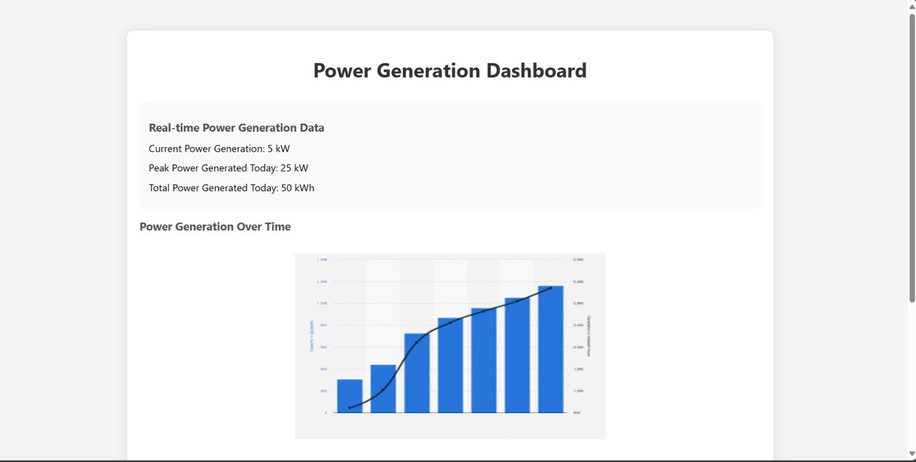
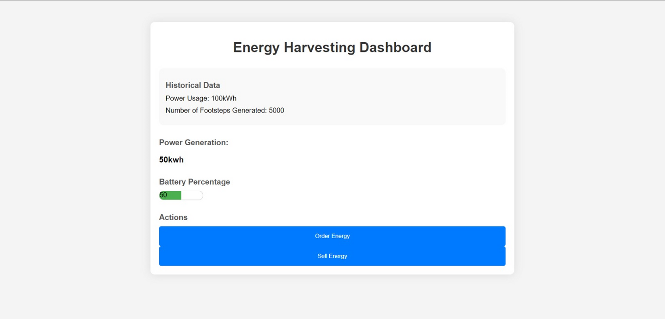
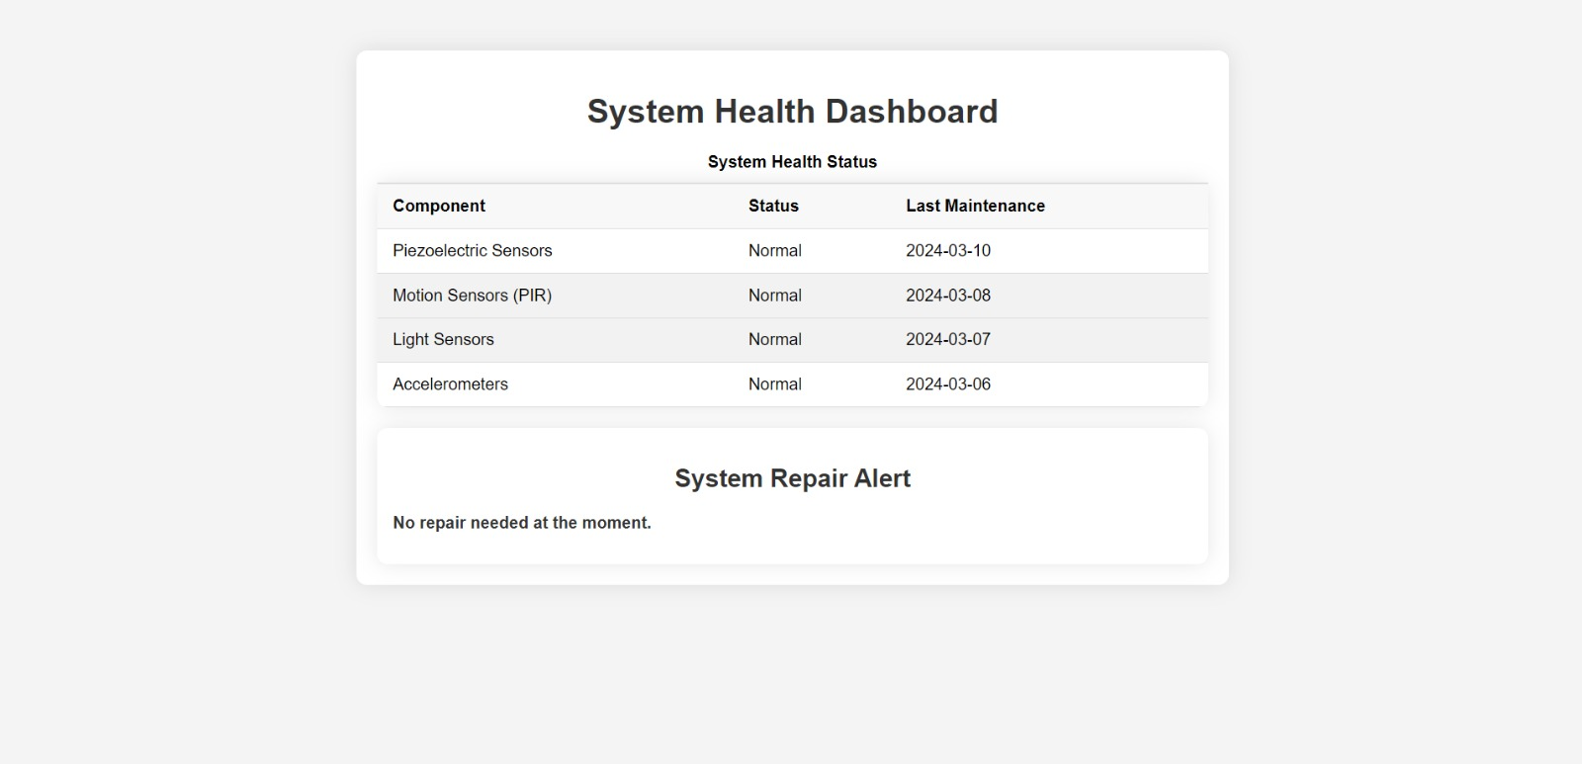
UI

Slide 21
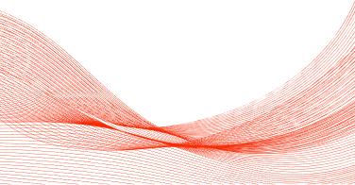
THANK YOU

